Slide 1
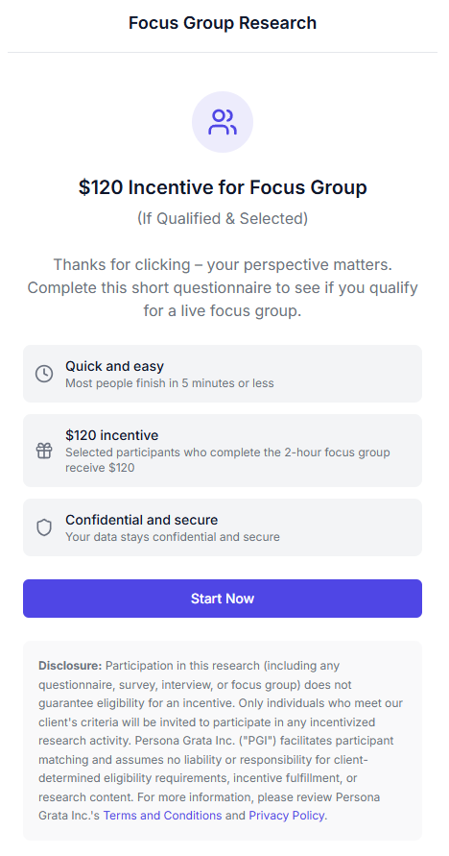
Before:

Slide 2

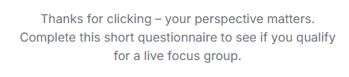
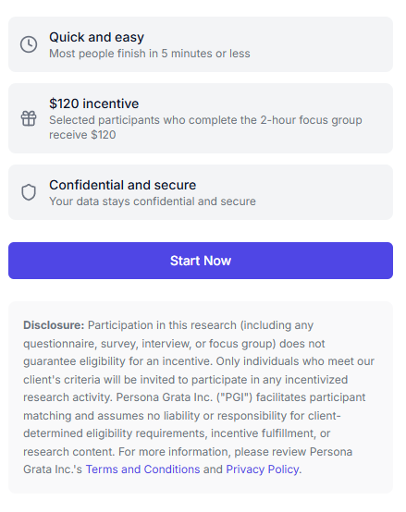
Upcoming Paid Focus Group Opportunity
(Limited Spots Available)
After:

